Slide 1
OISC/AI4DA
Focus Group Training
Steph Grohmann

Slide 2
Outcomes
At the end of this presentation, we hope that you:
Understand what a focus group is, what it is used for, and its strengths and limitations
Know the different steps involved in carrying out a focus group research project
Are aware of ethical issues in Focus Group research, such as informed consent and confidentiality
Understand key principles of focus group moderation
Know how to formulate good interview questions
Have an understanding of inclusivity and reflexivity in Focus Group research

Slide 3
What is a Focus Group?
“A focus group is the use of group interaction to produce data and insights that would be less accessible without the interaction found in a group” (Morgan 1988, p. 12)
“Focus Group Interviews typically have five characteristics or features. 1) people, who 2) possess certain characteristics, 3) provide qualitative data, 4) in a focused discussion 5) to understand the topic of interest” (Krueger & Casey, 2009, p.6)
Ca. 8-12 participants
Unlike a group interview, a focus group depends on interaction
Interviewer -> Moderator or Facilitator
Used to elicit views, experiences and perspectives

Slide 4
Qualitative vs quantitative research
Quantitative | Qualitative
Hypothesis testing | Eliciting views and experiences
Surveys and statistics | Interviews, focus groups, observations
Large, random samples | Small samples, often self-selecting
Aims for generalizability | Aims for particularity
“objective” | “subjective”
Positivism (“there is an objective world out there, we just need the right methods to measure it”) | Interpretivism (“there may be an objective world out there, but we can only access it from a subjective, situated viewpoint”)
Deals with Closed Systems (e.g. Experiment) | Deals with Open Systems (e.g. ‘Society’)
Asks “what” questions | Asks “why” questions

Slide 5
A Brief History of Focus Groups
First developed by Lazarsfeld & Merton (1940s) as “focussed interviews”
“Focus Group” term: Ernest Dichter (1991)
Origins in behavioural research during WWII:
boost military morale
examine effectiveness of propaganda
Later adopted in commercial research, but initially underutilized in Social Science:
Assess products and services
Assess effectiveness of advertising
From 70s: increasing use in social science, primarily health science, education, communication, psychology

Slide 6
Where are Focus Groups used?
Commercial research: designing and evaluating products and services
Non-Profit and Public sector: assessing practice and services, identifying gaps in provision, informing policy
Social Science research: general data gathering, support funding applications, part of mixed method research

Slide 7
Focus Groups: Pros and Cons
Pros | Cons
Richer data through mutual engagement | Without stringent moderation, risk of derailing
Relatively low investment of time and funds | Less suitable for sensitive topics
Group setting makes some people feel more comfortable | Group dynamics, e.g. informal hierarchy, conformism
Adaptable to many research questions | General risks of qualitative research: interviewer bias, lack of rapport...
Good to elicit conflicting views/controversies | Most often self-selecting sample

Slide 8
Focus Groups: Steps
Define topic/research question
Develop Interview Guide
Logistics
Informed Consent and Data Protection
Moderation
Data Analysis
Dissemination/debrief
Recruitment (incl. incentives)

Slide 9
Kinds of Questions
Interview questions: predetermined, fixed number, ca. 5-10
Defined follow-up (probing) questions: sub-questions to interview questions
Spontaneous follow up (probing) questions: can be asked to clarify a point or get more detail
Interview questions:
Opening
Introducing
Transition
Key Questions
Ending question

Slide 10
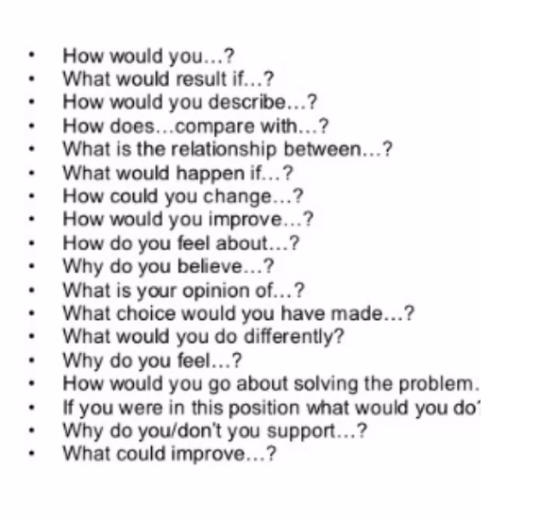
How to design questions
Open-ended (not answerable
with “yes” or “no”)
Neutral (not leading or partisan)
Clear (specific, free of jargon)

Slide 11
Recruitment
What respondent group?
Strangers, acquaintances, friends?
Self-selecting sample?
Minors/vulnerable people?
Accessibility?
Language?
Incentives?

Slide 12
Logistics
Location: accessibility
(travel, comfort,..)
Live or virtual?
Timing: 1-2hrs is enough for
most people
Setting: seating, lighting,
name tags…
Pre-and post moderation
Refreshments

Slide 13
Informed Consent and Data protection
Written or verbal consent
Specific consent for audio/video
Confidentiality
Data protection
Protection from harm
Intellectual property and attribution
Things to consider:
For minors/vulnerable people: proxy consent
Note taking instead of recording
Participants own recordings?
Potential (perceived) dependencies
Risk of distress from difficult topics
Risk of harm from other participants (hostility, breaking of confidentiality…)

Slide 14
Inclusivity
Are recruitment methods/materials accessible to the target group?
Does the target group have appropriate literacy/language level?
Is the group format accessible to the target group?
Is the topic considered sensitive by the target group?
Will the target group adhere to confidentiality?
Is the target group comfortable with unstructured socializing/debate?
How is the target group structured (e.g. formal or informal hierarchies)?

Slide 15
Reflexivity
Be mindful of interviewer bias!
Topic (leads to leading questions!)
Background: race, gender, class, sexuality…
Norms: Social, cultural and linguistic norms
Communication: Neurotypicality/ablebodiedness

Slide 16
Moderation
“Empathy and positive regard are critical qualities of the moderator” (Krueger and Casey, 2009, p86)
BUT: empathy works best with those who are most similar to us!
Ground rules:
Mutual respect (e.g. no slurs, insults)
Letting each other finish/not interrupting
Giving everyone a chance to speak
Not an exam: there is not one “right” opinion
Right to withhold statements

Slide 17
Moderator roles
Be aware of interview guide and participants (names etc.)
Establish comfortable setting, reassure, set expectations
Bridge ‘gaps’ in debate
Leave people time to think
Keep comments neutral and non-judgmental
Invite diverse opinions (”does anyone have a different viewpoint?”)
Don’t take sides!
Don’t offer advice or quick solutions
Keep track of time for individual contributions and overall group

Slide 18
Strategies for dealing with conflict
Create an environment that fosters equality by encouraging quieter group members and setting boundaries for more dominant ones
Make clear from the beginning what behavior will not be tolerated (e.g. slurs, insults) and the consequences (e.g. person will be asked to leave)
Leave discussion of controversial topics towards the end, when an amount of trust has been established
Acknowledge different views but do not judge or take sides
If conflict cannot be avoided, mediate if possible by finding commonalities
With controversial topics, be aware of likely triggers for conflict and have a mediation plan
Know your limits: if you cannot remain neutral on an issue, don’t do a Focus Group on it

Slide 19
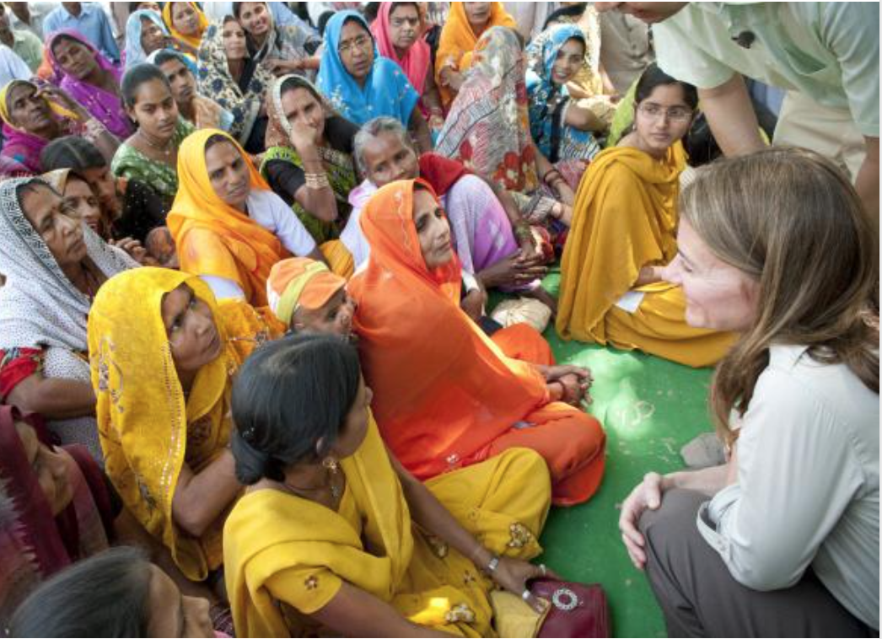
Data analysis:
Transcription?
Analysis method:
Qualitative Content Analysis
Thematic Analysis
Grounded Theory, etc…
Theory?
Statistics??
Help!
-> more next time!

Slide 20
Dissemination:
Be clear to respondents about what you will do with their data and why
Retain contacts (with consent) and keep respondents informed
Consider a debriefing session
Think about attribution

Slide 21
Thank You!!

